Slide 1


Nirav Raje Capstone
Machine Learning Guild Apprentice Program

Slide 2
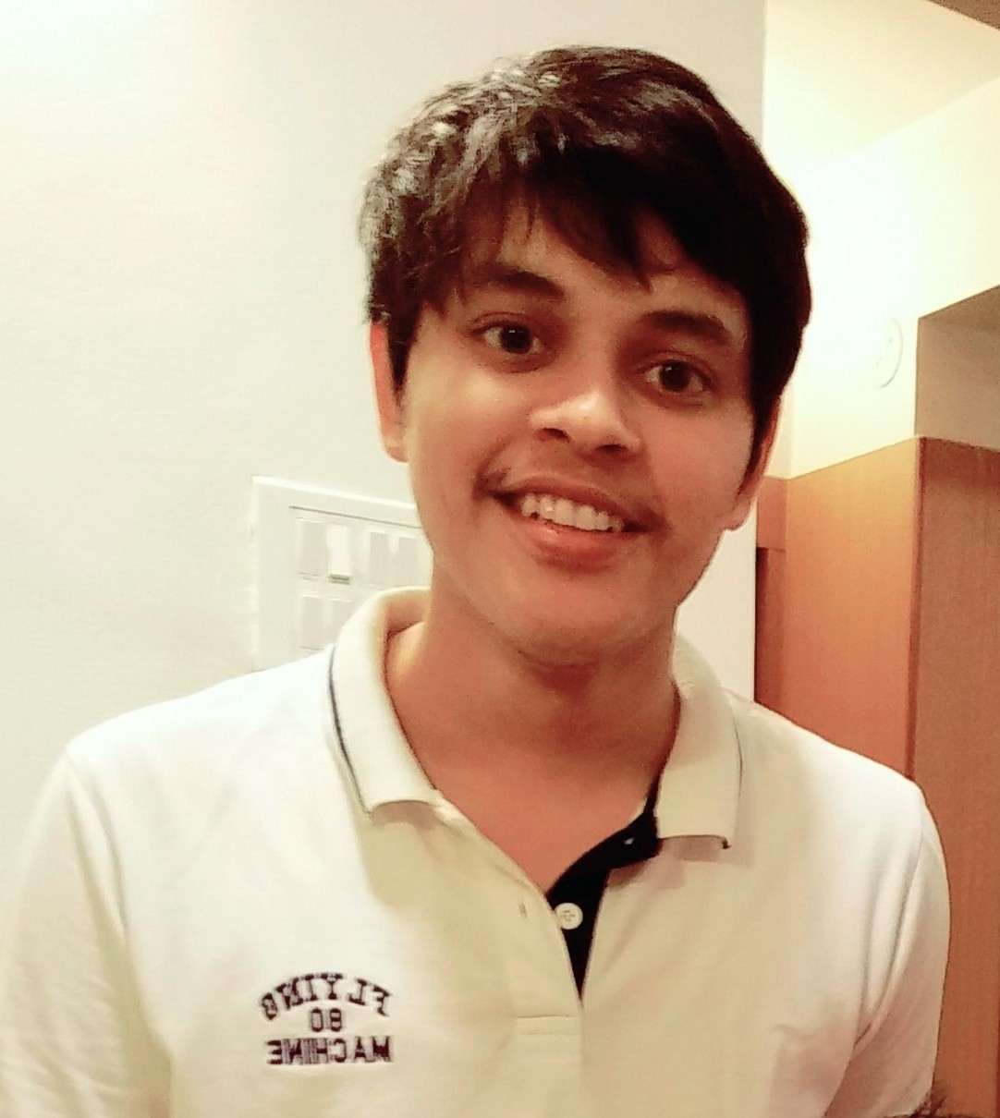
Introduction – Nirav Raje
Why am I learning about Machine Learning and Artificial Intelligence?
To contribute in making ML more accessible through web or Android apps.
To be capable of narrating the story behind the data/modeling to the stakeholders and to contribute to making ML more interpretable.
Biographical Details
Level: Analyst
Offering Portfolio: HRT (HC)
Offering: Workday Integration
Industry / Sector: Technology, Media and Telecom

Slide 3
Capstone
Overview & Major Highlights

Slide 4
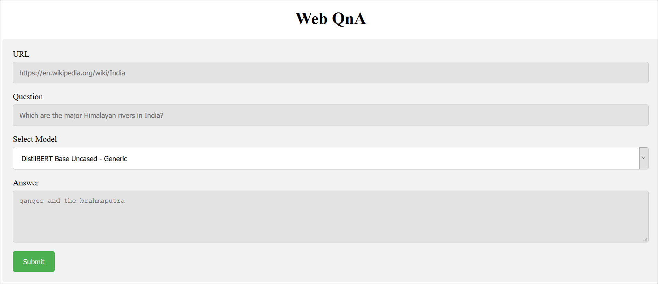
Question Answering System for Web Pages
A web app that allows the user to ask questions on any web page.
ISSUE
SOLUTION
We rely on Google for most of our questions. This search engine has a ~92 market share and receives around 40K search queries every second.
Google does a really good job at retrieving the most relevant document to our question or sometimes populates the answer directly.
However, after opening a web page, there is no easy way to ask follow-up questions that are specific to the content on the web page.
The in-built Search feature (Ctrl+F) relies on direct word matching – doesn’t really take any effort on understanding our question. Frustrating if there are too many instances of the word/phrase we are searching.
Regular expression approaches doesn’t consider similar meaning words.
A web application that can scrape natural language text from any online article and leverages modern NLP techniques to answer a question input by a user.
Task 1: Real time web scraping and pre-processing the article text and the question.
Task 2: Generation of a “context” i.e. generating a paragraph of sentences which are most likely to contain the exact answer.
Task 3: Extracting the exact answer phrase from this context using a deep learning model.
IMPACT
We need a smarter user-friendly tool that “understands” our question, “reads” the long text for us on a semantic level and then returns the exact answer.
Such a tool would save research time and efforts in reading long articles – basically do the reading for us.
Provide a much more efficient alternative for the direct word matching search.
4

Slide 5
Data Acquisition
For Evaluation of Context Generation Techniques
Built a custom question-answer pair JSON file on a random Wikipedia article.
100 randomly selected question-anwers pairs were used to validate against the context generation models.
For Evaluation/Comparison of Answer Extraction Models
Generic: SQuAD 2.0 dataset (100k+ question answer pairs and 50k+ no answer pairs)
Domain-specific: Deepset’s CovidQA dataset (2153 question answer pairs)
For Inference
Used BeautifulSoup4 to perform real time web scraping.
Given a URL, the system would scrape the article’s text data, remove noise, remove stop words and lemmatize as needed for each model/technique.

Slide 6
Models/Techniques Implemented
Context Generation
Answer Extraction and Fine-tuning on Domain Specific Custom Dataset
1
Bag of Words
DistilBERT Base Uncased – Fine-tuned on
2
1
TF-IDF Model
SQuAD2.0 dataset
3
Gensim Word2Vec and Doc2Vec
2
Only CovidQA dataset
4
GloVe (word) + InferSent (sentence)
3
SQuAD2.0 + CovidQA dataset
5
KNN, K-Medoids Clustering

Slide 7
Performance Evaluation – Context Generation Techniques
Model | Distance Metric | F1 Score | EM Score
Bag of Words | Cosine | 0.371 | 0.29
TF-IDF | Cosine | 0.036 | 0.00
Gensim: Word2Vec + Doc2Vec (trained on article text only) | Cosine | 0.368 | 0.29
GloVe (word vectors) + InferSent (sentence encoder) | Cosine | 0.6 | 0.59
Performance Comparison of fine-tuned BERT QA models on CovidQA test data
Base Model | Fine-tuned On | F1 Score | EM Score
DistilBERT Base Uncased | Only SQuAD 2.0 dataset | 0.294 | 0.163
DistilBERT Base Uncased | Only CovidQA dataset | 0.036 | 0.004
DistilBERT Base Uncased | SQuAD 2.0 + CovidQA | 0.234 | 0.097

Slide 8
Approach Overview
Answer
Phrase
Web Text
Data
Text Pre-processing and
Tokenization
Generate
Word Embeddings
(GloVe)
Generate
Sentence Embeddings
(InferSent)
Real-time web scraping of text using BeautifulSoup4
Map 0s for Segment A and 1s for Segment B tokens
Segment A
Tokens
Context is built using the top ‘N’ most similar sentence embeddings to the question embedding.
Condition:
(Question Tokens + Context Tokens) < 512
Cosine Similarity Search
(Generating
Embedded
Context)
Distil
BERT
Context
Sentence
IDs
Context
Tokens
Mapping
Segment
IDs
Question/Query input by user
Question
Tokens
Question
Text
Text Pre-processing and
Tokenization
Generate
Word Embeddings
(GloVe)
Generate
Sentence Embeddings
(InferSent)
SQuAD
2.0
Dataset
Segment B
Tokens

Slide 9
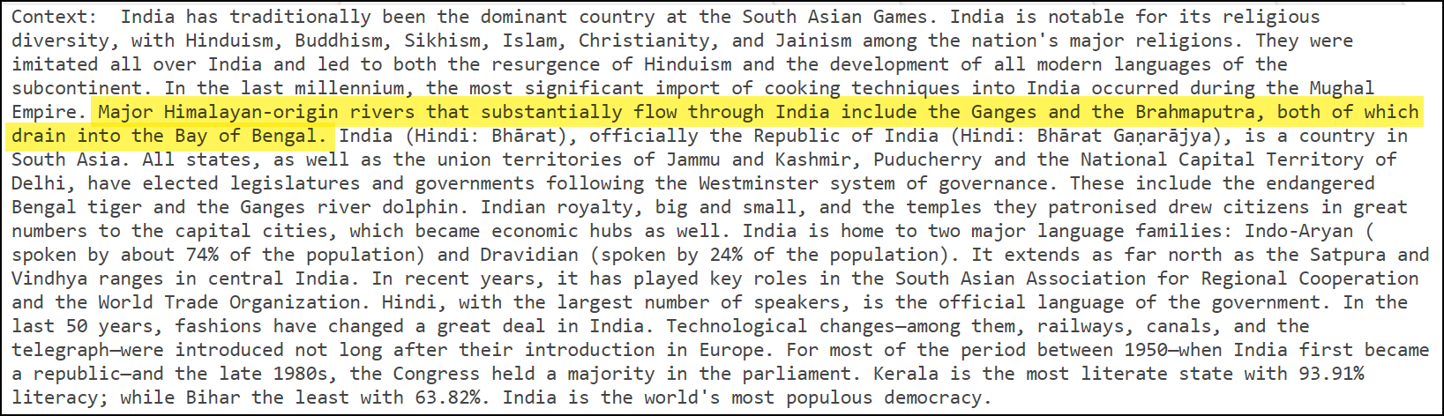
Example
Input Question
Web Page URL
Which are the major Himalayan rivers in India?
Context Generation Module
(GloVe + InferSent)
https://en.wikipedia.org/wiki/India
Answer Extraction Module
(DistilBERT)
Cleaning and merging the answer tokens

Slide 10
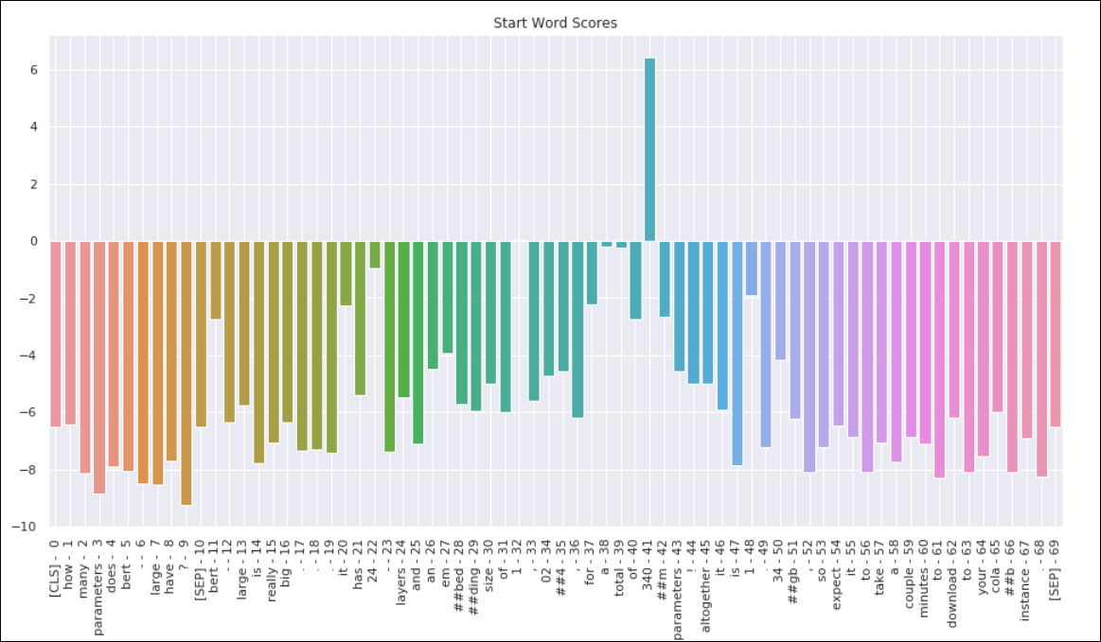
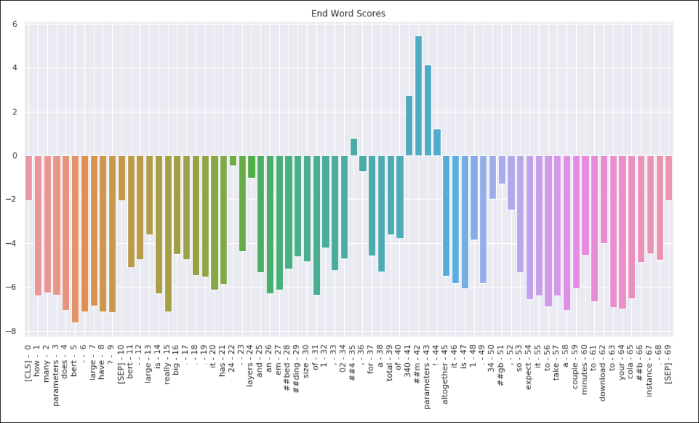
Answer Phrase Extraction – Start and End Word Scores

Slide 11
Demo

Slide 12
Learning Outcomes

Slide 13
Conclusion & Next Steps
And our skills grow
Your Learning Outcomes
Growing Your Mastery
Deep learning for NLP
Improved research skills by extensively reading papers, GitHub repositories.
Challenges of evaluating NLP models – a single extra character can affect EM score even though prediction is the same.
Understanding the challenges of “No Answer” predictions by QnA models.
Using ML models in Flask applications.
Work on more projects, Kaggle competitions on NLP.
Courses, projects in Deep Learning
Future Work
Deploying as a Chrome/Firefox browser extension.
Exploring domain specific QnA applications within Deloitte.
QnA on PDFs, Outlook mails.

Slide 14
Thank You!

